Slide 1
EUROPÄISCHES SPRACHENSIEGEL NATIONAL REPORT: GERMANY
Outline

Slide 2
ORGANISATION OF THE SCHEME
Each year one of three separate agencies take turns in running the scheme:
2010:DAAD - the German Academic Exchange Service
2011: PAD - Pädagogischer Austauschdienst, the only public body working on behalf of the Federal States to promote international exchange and cooperation in the school sector - (Kultusministerkonferenz).
2012: BIBB - the Federal Institute for Vocational Education and Training

Slide 3
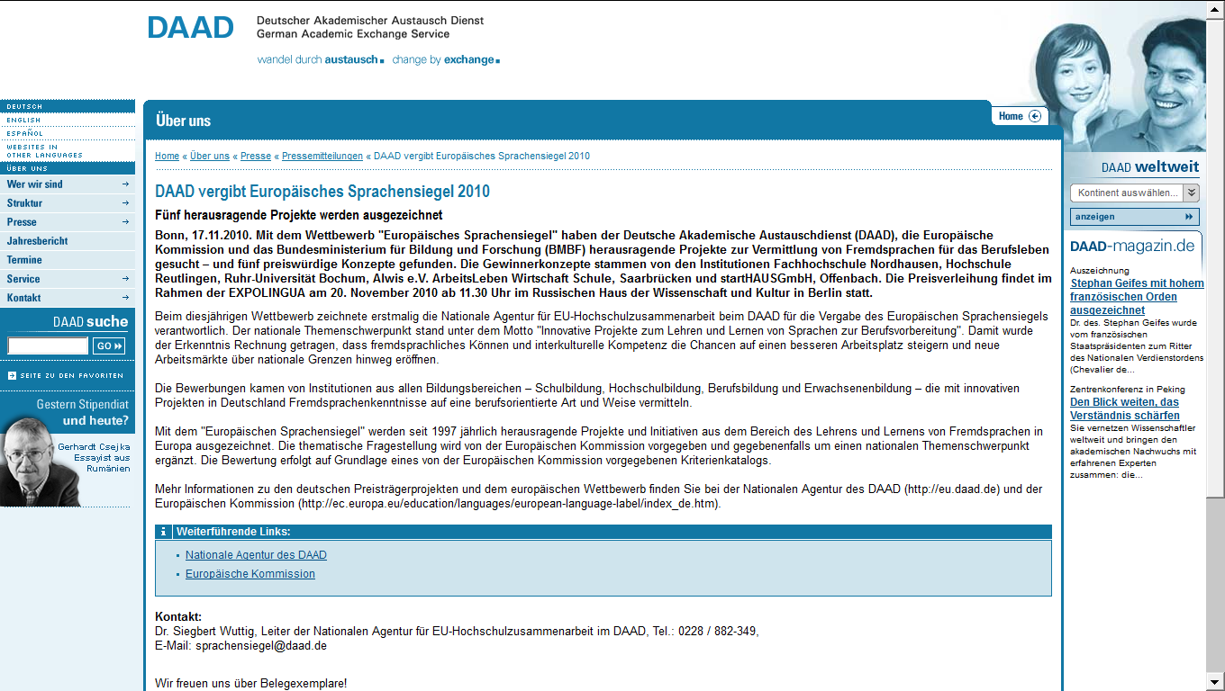

Slide 5
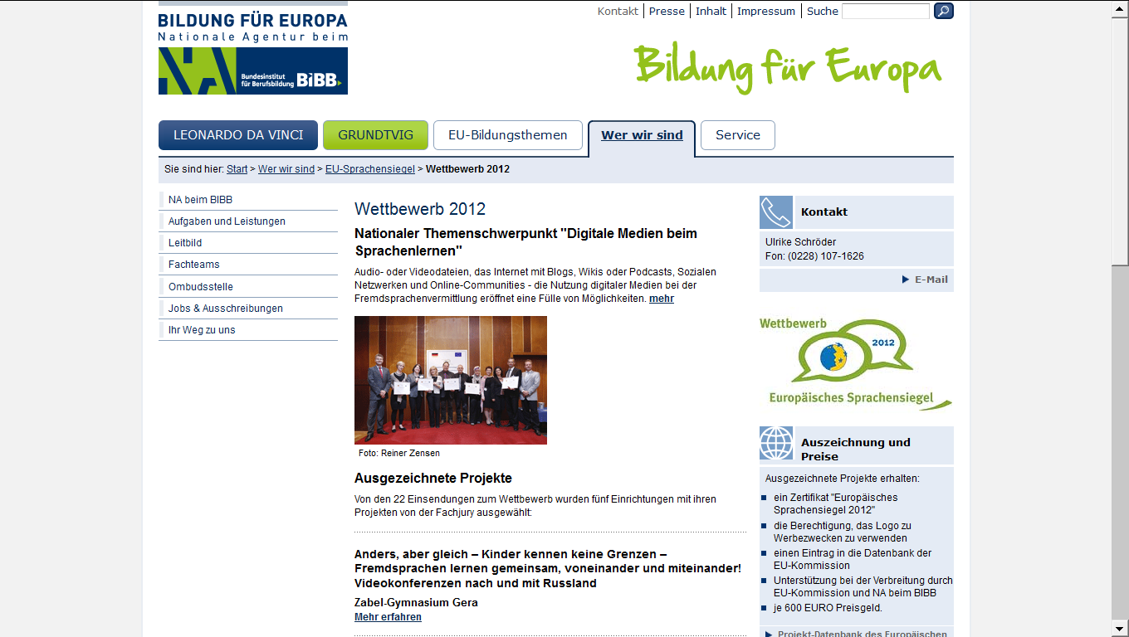

Slide 6
NEW THEME EACH YEAR
The overall theme for the awards changes each year:
2007: qualification and training of language teachers and trainers
2008: Intercultural dialogue in language learning
2009: plurilingualism (described as “Europe’s trump card in innovation and creativity”).
2010: foreign language training for professional life
2011:“language learning in the community – using resources and building competences”.
2012: digital media in language learning.

Slide 7
APPLICATIONS
The awards attract a broad range of educational institutions in Germany, from primary schools, secondary schools and in vocational training and universities.
Some of the projects are local, for example tandem learning in two primary schools on either side of the German-Polish border
others, such as a project bringing together chefs in vocational training, are Europe-wide.

Slide 8
AWARDS & THE AWARD CEREMONY
The 2012 awards were announced in Bonn (26th October), and five projects were chosen, compared to nine in 2011.
In 2008, exceptionally, one project was awarded a first prize, with a ‘runner up’ prize to the eight other awards.
Each year the award ceremony is held in different locations, not always in Germany: in 2011 it was held in Vienna
This enables winners running projects in the German language to learn about each others’ work.

Slide 9
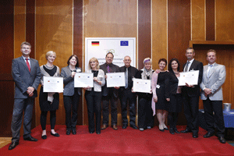

Slide 10
THE PROS AND CONS OF ROTATION AMONG DIFFERENT AGENCIES
PRO: attracts a broad spectrum of different kinds of project from different sectors of education, so there is a good balance between schools, adult education and universities
CON: it can mean that the follow-up and promotion of the awards is not optimal as the awarding body is not involved in the two following years. It is also harder for those interested (including EAQUALS…) to find the information they need, application forms etc.

Slide 11
RECOMMENDATIONS
Unify efforts to bring the scheme to the attention of potential applicants e.g. by providing:
a single ‘Sprachensiegel’ website (or webpage) that clarifies which organisation is in charge in which year with links directly to the application form on the relevant website
A single German list of all winning projects over the years
Look for ways to maintain greater visibility for projects after the award, e.g. by creating a network of project leaders.

